Slide 1
RNAseq Analysis

Slide 2
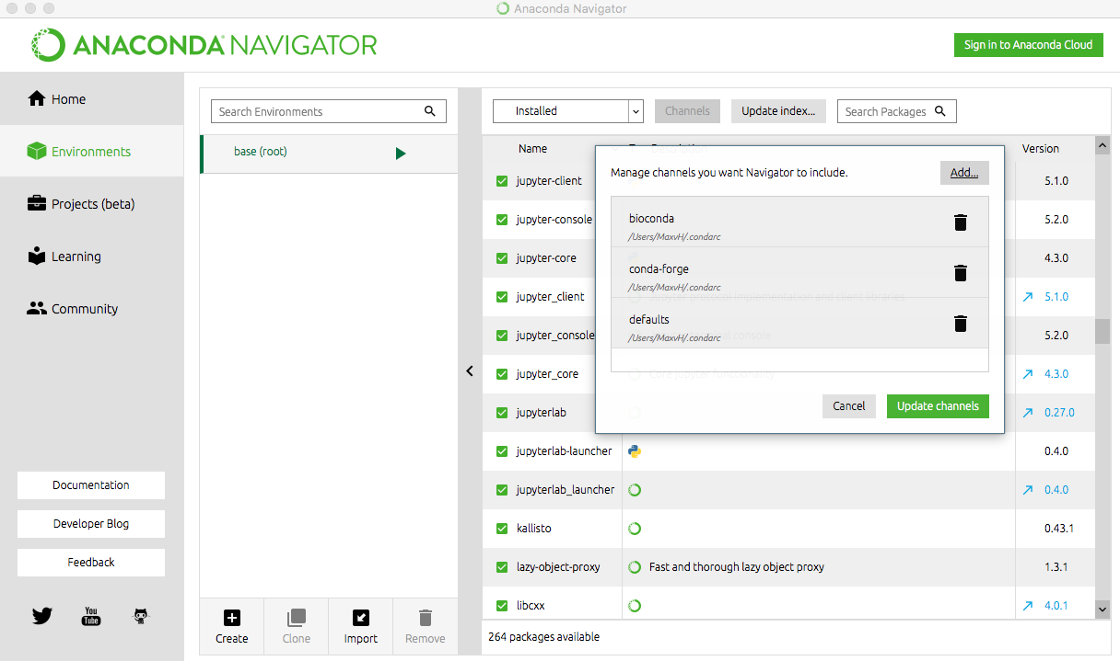
If you are on either Mac or Linux, start with installing Anaconda navigator (see github for link). Windows will have to install software separately.
link to github lesson: https://tinyurl.com/y9msejcf OR
https://github.com/ScienceParkStudyGroup/studyGroup/tree/gh-pages/lessons/20180220_RNA-Seq_Max_and_Fred

Slide 3
Experimental design
-What do you want to test?
-Will your samples give you your answers?
-grow condition & # plants
-media -tissue
-age -stress
How many samples can you afford
Sequencing platform
short reads
-Illumina
-SOliD
Long reads
-Ion torrent
-Pac bio
-roche 454
Notes:
THink about what you want to do. Don’t just sequence because you can.
Will your growth condition be representative for your experiments. How may plants will you have in a sample. (1 or lots)
Sequencing platforms. You can go for either shorter reads, which is good for re-sequencing, or long reads which are better for de novo genomes. Off course $$ even more important.

Slide 4
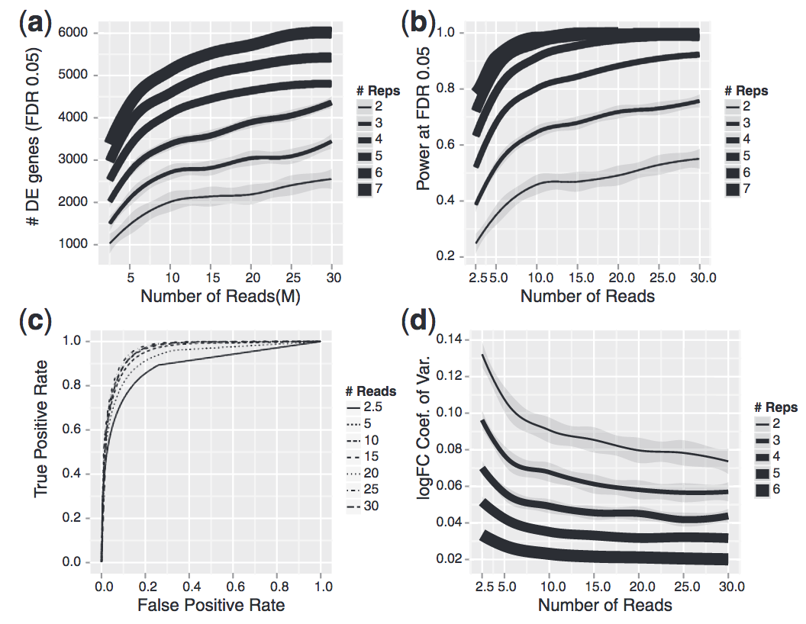
# samples matter more than # of reads
RNA-seq differential expression studies: more sequence or more replication? White et al 2013
Notes:
Be sure to have a good # of samples, you don’t need that many reads, better invest in another sample.

Slide 5
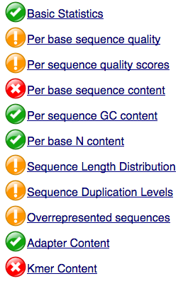
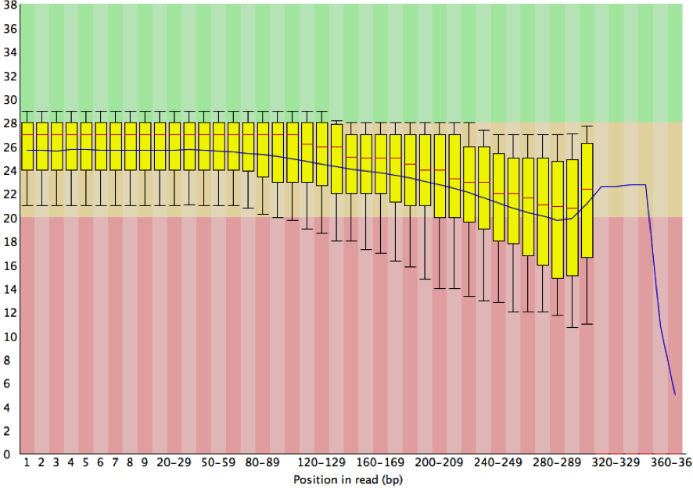
FastQC
Quality score
Notes:
Can check your quality of our samples in many ways. First is average quality per base

Slide 6
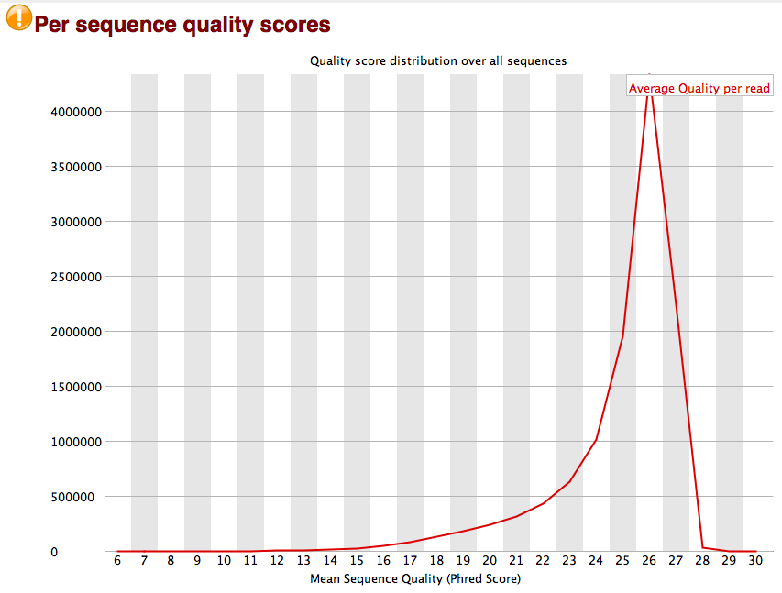
FastQC
Notes:
Quality distribution

Slide 7
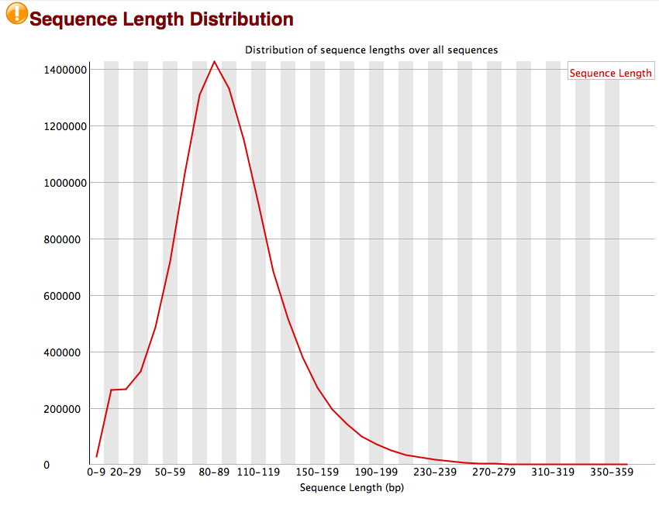
FastQC
Notes:
Size of reads

Slide 8
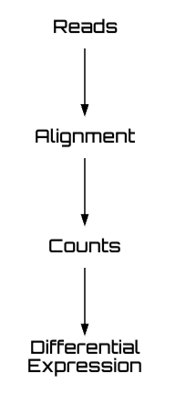

Slide 9
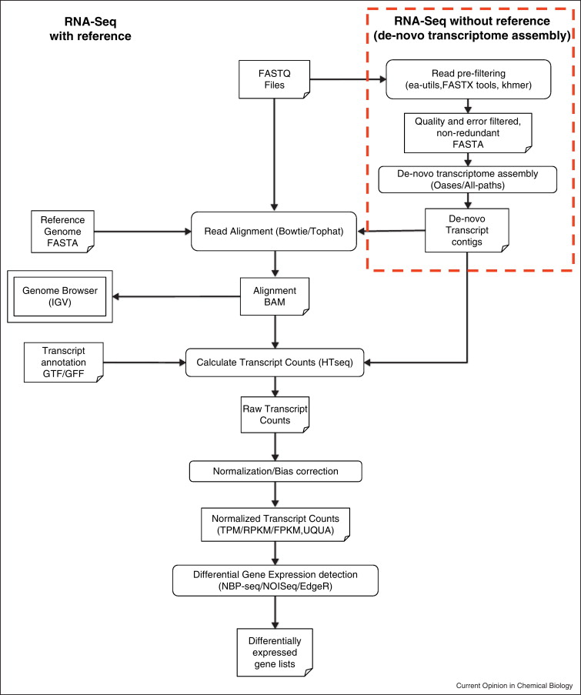
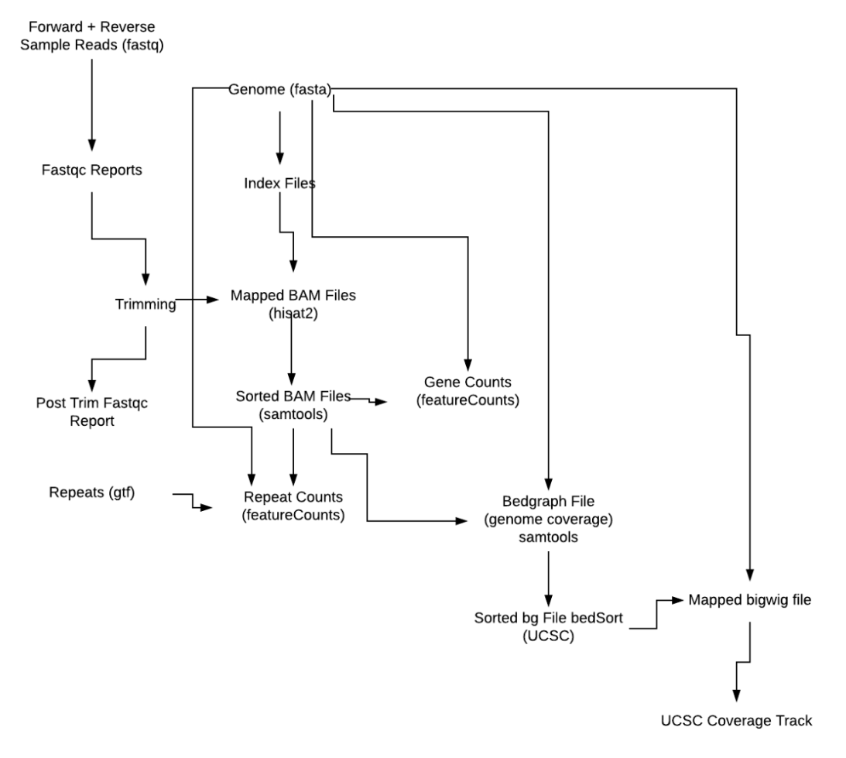
Workflow Model

Slide 10
Metrics to consider when choosing the aligner
On-target hits
False positives
User time
Memory Consumption
Splice variant considerations
Analysing for genes or transposable elements

Slide 11
Mapper | Pros | Cons
Bowtie/Tophat | Widely used, Developed for splice variants, Output Cufflinks compatible | Time, Memory Consumption
STAR | Widely used, Used by ENCODE, Clear documentation | Time, Memory Consumption
Hisat | Widely used, Works well with Cufflinks | Conservative hit rate, Time, Memory Consumption
Kallisto | Speed, Accuracy, Ease of use, Specifically developed to circumvent multimapping problem (i.e. splicing and repeats) | Small user base

Slide 12
Differential Expression | Pros | Cons
EdgeR | Can be used without replicates (with caution) | Works with CPM
Cuffdiff | Widely used, Combined with CummeRbund (R package) | Blackbox
DESeq2 | Can be used without replicates (with caution) | Input must be integer
Sleuth | Ease of use, Optimised for small no. of replicates, | Small user base

Slide 13
Aligners or pseudo-aligners
Genome alignments are time consuming and do not always result in optimised mapping, especially for repeats.
Advances in bioinformatic algorithms have attempted to circumvent this problem by pseudo-mapping to a transcriptome to quantify transcript abundance directly from the raw sequence reads (fastq files)
Kallisto: a recent update in RNAseq analysis

Slide 14
Pseudo aligners - Kallisto
Kallisto/Sleuth analysis has a similar workflow
BUT alignment to a transcriptome fasta file
Speedier analysis as not forced to properly align to the entire genome
Notes:
Kallisto outperforms all other methods on speed and is highly competitive on accuracy too (Pachter et al., 2016; Schaeffer et al., 2017)
Doesn’t lose information through k-mer segmenting as in sailfish

Slide 15
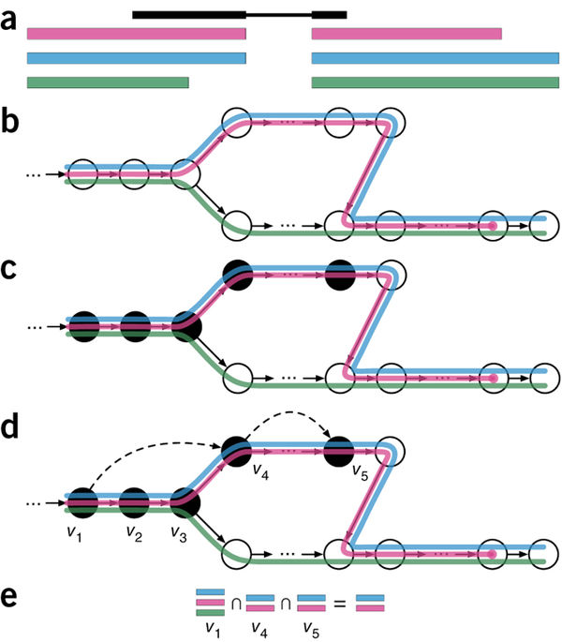
How does Kallisto Work?
Example Kallisto Run
Read example, with three overlapping potential transcripts to map to.
Index made through T-DBG, nodes are k-mers, coloured paths = transcripts. The paths create a k-compatibility class over the nodes per k-mer.
K-mers are hashed in order to find this k-compatibility.
If a k-mer is redundant i.e. has the same k-compatibility to each node then the hashing skips to the next k-mer of the sequence (redundancy is marked as dotted lines).
K-compatibility class of each read is determined by the intersection of the compatibility classes of its constituent k-mers.
Figure 2 Kallisto Schematic
(Bray, Pimentel, Melsted & Pachter, 2016)

Slide 16
References
Bray, N. L., Pimentel, H., Melsted, P., & Pachter, L. (2016). Near-optimal probabilistic RNA-seq quantification. Nature biotechnology, 34(5), 525.
Conesa, A., Madrigal, P., Tarazona, S., Gomez-Cabrero, D., Cervera, A., McPherson, A., ... & Mortazavi, A. (2016). A survey of best practices for RNA-seq data analysis. Genome biology, 17(1), 13.
Otto C, Stadler PF, Hoffmann S: 'Lacking alignments? The next generation sequencing mapper segemehl revisited', Bioinformatics. 2014 Jul 1;30(13):1837-43 (2014)
Law, C. W., Chen, Y., Shi, W., & Smyth, G. K. (2014). voom: Precision weights unlock linear model analysis tools for RNA-seq read counts. Genome biology, 15(2), R29.
Love, M.I., Huber, W., Anders, S. (2014) Moderated estimation of fold change and dispersion for RNA-seq data with DESeq2. Genome Biology, 15:550. 10.1186/s13059-014-0550-8
Patro, R., Duggal, G., Love, M. I., Irizarry, R. A., & Kingsford, C. (2017). Salmon provides fast and bias-aware quantification of transcript expression. Nature methods, 14(4), 417.
Pimentel, H., Bray, N. L., Puente, S., Melsted, P., & Pachter, L. (2017). Differential analysis of RNA-seq incorporating quantification uncertainty. Nature methods, 14(7), 687.
Ritchie, M. E., Phipson, B., Wu, D., Hu, Y., Law, C. W., Shi, W., & Smyth, G. K. (2015). limma powers differential expression analyses for RNA-sequencing and microarray studies. Nucleic acids research, 43(7), e47-e47.
Robinson, M. D., McCarthy, D. J., & Smyth, G. K. (2010). edgeR: a Bioconductor package for differential expression analysis of digital gene expression data. Bioinformatics, 26(1), 139-140.
Trapnell, C., Pachter, L., & Salzberg, S. L. (2009). TopHat: discovering splice junctions with RNA-Seq. Bioinformatics, 25(9), 1105-1111.

Slide 17
Useful Link
Kallisto/Sleuth support group:
https://groups.google.com/forum/#!forum/kallisto-sleuth-users

Slide 18
Kallisto output and UCSC
kallisto quant --pseudobam argument outputs a file compatible with samtools
"samtools view -b {input.bam} | bedtools genomecov -split -bg -ibam stdin -g {input.genome} > {output.bg}"
"bedSort {input.bg} {output.sorted.bg}"
"bedGraphToBigWig {input.bedgraph} {input.chroms} {output.bw}"

Slide 19
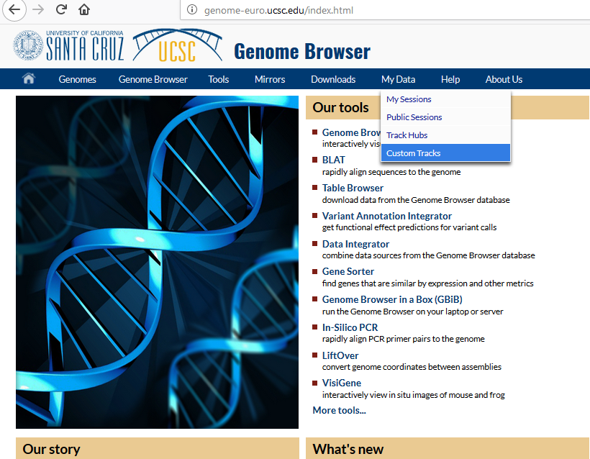
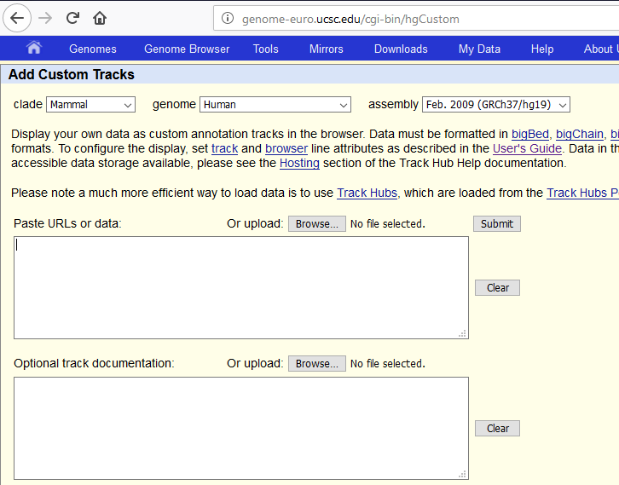
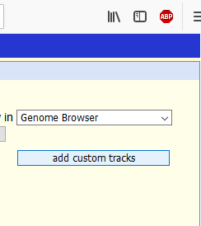
Getting the Results to UCSC
Fred; Put in jupyter notebook after approval from Nina...

Slide 20
